Slide 1
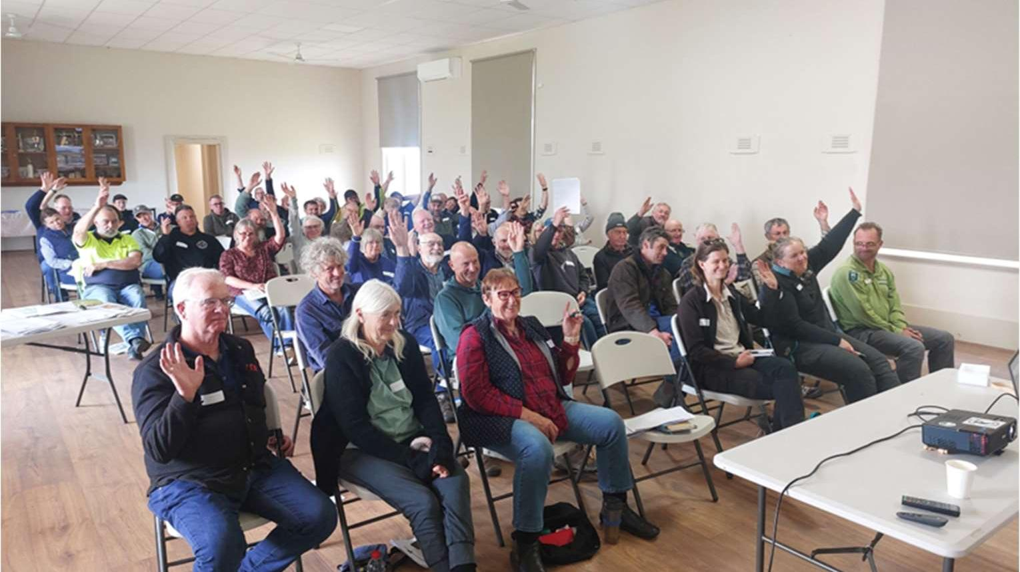
PARTNERSHIPS AGAINST PESTS
Grants Program Round 5
Webinar – 27 March 2026
“Who has a rabbit problem?” PAP Round 3 funded Rabbit Control Event
Courtesy of Warrnambool Coastcare Landcare Network, 2024.
Taradale Weed control ID and field day, funded in PAP Round 2
Courtesy of Connecting Country, 2024.

Slide 2

Acknowledgement of Country
We acknowledge and respect the Victorian Traditional Owners as the original custodians of Victoria’s land and water, their unique ability to care for Country and deep spiritual connection to it.
We honour Elders past and present whose knowledge and wisdom has ensured the continuation of culture and traditional practices.
DEECA is committed to genuinely partnering with Victorian Traditional Owners and Victoria’s community to progress their aspirations.

Slide 3



Housekeeping
This session is being recorded
The recording, transcript and slides will be available on the Partnerships Against Pests Grant Program website
Cameras, microphones and chat function are turned off
Questions can be asked via the Q&A icon at the top of the screen
There will be time for any other questions at the end of the
session

Slide 4
Agenda
1
Overview of the Partnerships Against Pests Program
The Program
Grants recipients
Outputs, target species and feedback
Prior Grant Recipient: Project Platypus
2
Partnerships Against Pests Grants Program Round 5
Objectives
Changes for Round 5
Criteria
Eligibility
3
Applying for a Round 5 Partnerships Against Pests Grant
Application process
Budgets and funding
Learnings from previous applicants
Application process and dates
4
Wrap up
Q&A
Resources

Slide 5
Overview of the Partnerships Against Pests Program
The Program
The Grants

Slide 6

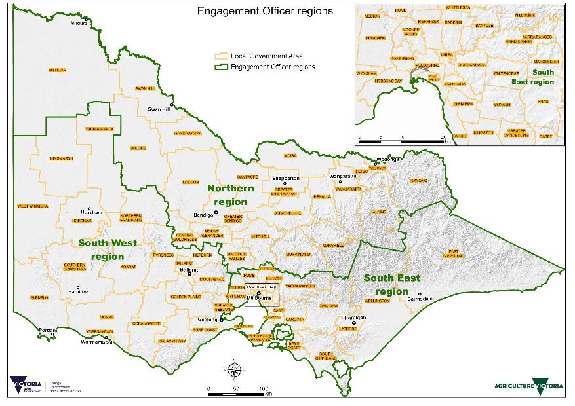




Partnerships Against Pests Program
THE PARTNERSHIPS AGAINST PESTS PROGRAM HAS 4 COMPONENTS WHICH AIM TO IMPROVE AND STRENGTHEN THE ESTABLISHED INVASIVES MANAGEMENT SYSTEM
Partnerships Against
Pests Grants Program
Victorian Invasive Pests Advisory Board (VIPA)
Funding and supporting
Victoria’s 4 Community Pest
Management Groups (CPMGs)
Alastair Campbell
Funding AgVic
Engagement Officers
to support community
groups
Doug May
David Scott

Slide 7
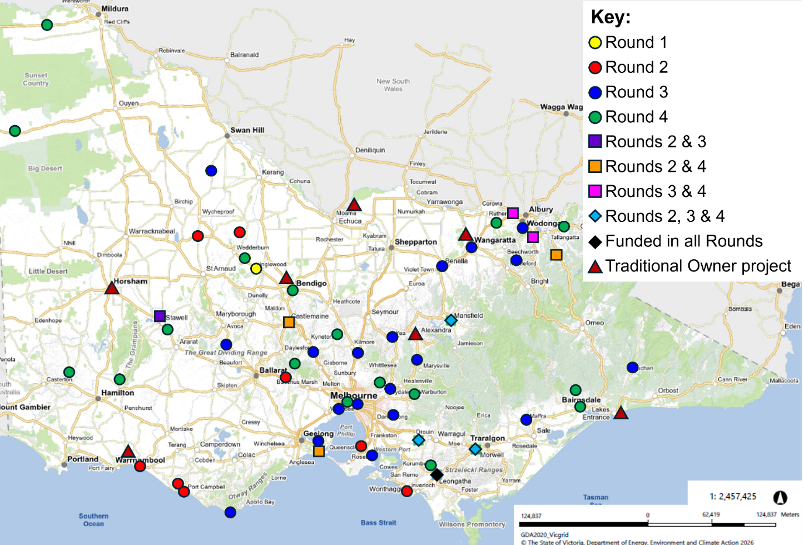
Grants Recipients
SINCE 2023, THE PAP GRANTS PROGRAM HAS FUNDED:
70 PROJECTS DELIVERED BY 55 COMMUNITY GROUPS
Round 1 – 2 projects
Round 2 – 16 projects
Round 3 – 25 projects
Round 4 – 27 projects
21 PROJECTS DELIVERED BY STATEWIDE CPMGs
7 PROJECTS DELIVERED BY TRADITIONAL OWNERS

Slide 8
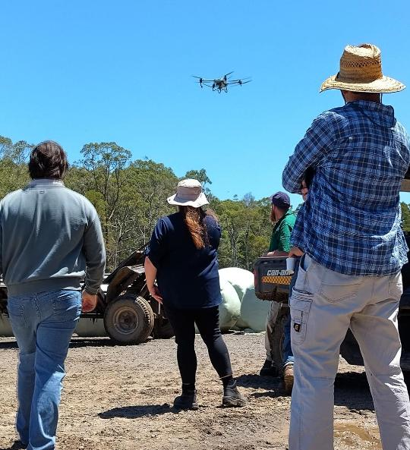
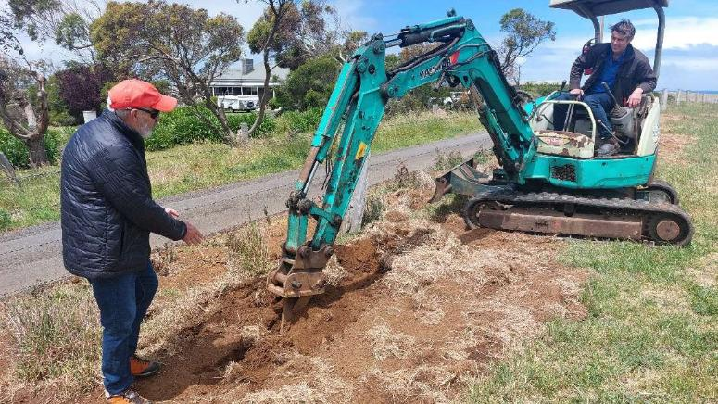
Outputs Overview
OVER $3.4 MILLION IN FUNDING HAS BEEN COMMITTED BY THE PARTNERSHIPS AGAINST PESTS GRANTS PROGRAM TO DELIVER COMMUNITY CAPACITY BUILDING PROJECTS
The grants have funded 70 community groups projects. These projects have planned or completed over 2090 outputs and activities, including:
115 field days
65 training events
165 workshops
25 webinars
32 videos
VRAN’s Tim Bloomfield explaining best practice rabbit warren ripping technique at Warrnambool Coastcare/Landcare’s Rabbit Control Event, part of their Round 2 project Developing partnerships against pests in Southwest Victoria. Image courtesy of Warrnambool Coastcare/Landcare Network, 2024.
Drones for weed control demonstration at Heytesbury District Landcare Network’s Scotts Creek Weedbuster event, part of their Round 2 project Pest-busting strength through community connection in the Heytesbury.
Image courtesy of Heytesbury District Landcare Network, 2024.

Slide 9
Target Species Overview
OVER THE FIRST 4 ROUNDS, THESE WERE THE MOST TARGETED CATCHMENT AND LAND PROTECTION ACT 1994 (CALP act) LISTED WEED AND PEST ANIMAL SPECIES
Weeds
Pest Animals
Key:
Round 1
Round 2
Round 3
Round 4
1
1
Ragwort
Sweet Briar
Hawthorn
Rabbits*
Foxes
Feral Cats
Feral Pigs
Feral Goats
Gorse*
Blackberries*
Broom species
Bridal Creeper
African Boxthorn
Wheel Cactus
Willow species
Cape Tulip species
Thistle species
Serrated Tussock*
African Love Grass
Boneseed
Paterson's Curse
Chilean Needle Grass
Watsonia species
Spiny Rush
St. John’s Wort
Bathurst Burr
Horehound
*CPMG target species
Notes:
Note: these graphs only show CaLP species which have been listed as a target species in 5 or more grant applications.

Slide 10
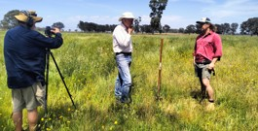
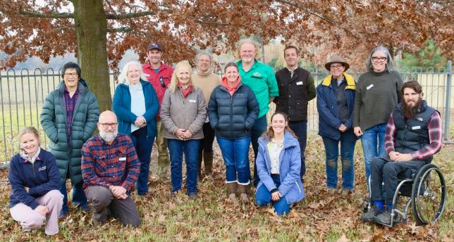
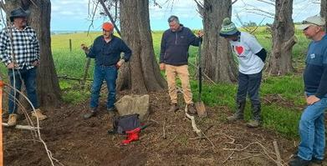
Grants Feedback
“Landholders who attended our workshops now have an opportunity to become local leaders, promoting best-practice information on blackberry management. Our ability to engage with several new people through this workshop series has also increased the extent of our knowledge dissemination”.
“Multiple community members/property owners who attended the VRAN bootcamp are now in a position to be able to take a leadership role amongst their own community. At the bootcamp they were able to connect well with public land managers and also learn many examples of successful collaborative approaches to rabbit control.”
“This grant allowed MDLN to engage professional film makers and consultants to create high quality short films that will be of great interest to our community moving forward.”
Nick Gannon and Declan Mcdonald filming a weed management video for Maffra District Landcare Network. Image courtesy of Maffra District Landcare Network, 2025.
The attendees of Kiewa Catchment Landcare Network’s blackberry mapping event. Image courtesy of Kiewa Catchment Landcare Network, 2025.
VRAN mentors Tim Bloomfield and Brad Spear demonstrated best practice rabbit management at a bootcamp hosted by South Gippsland Landcare Network. Image courtesy of South Gippsland Landcare Network, 2025.

Slide 11

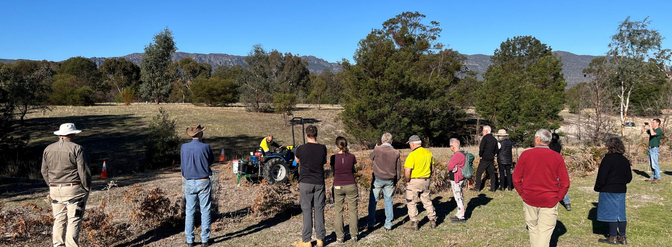
Guarding Gariwerd project
Slides and images courtesy of Project Platypus

Slide 12
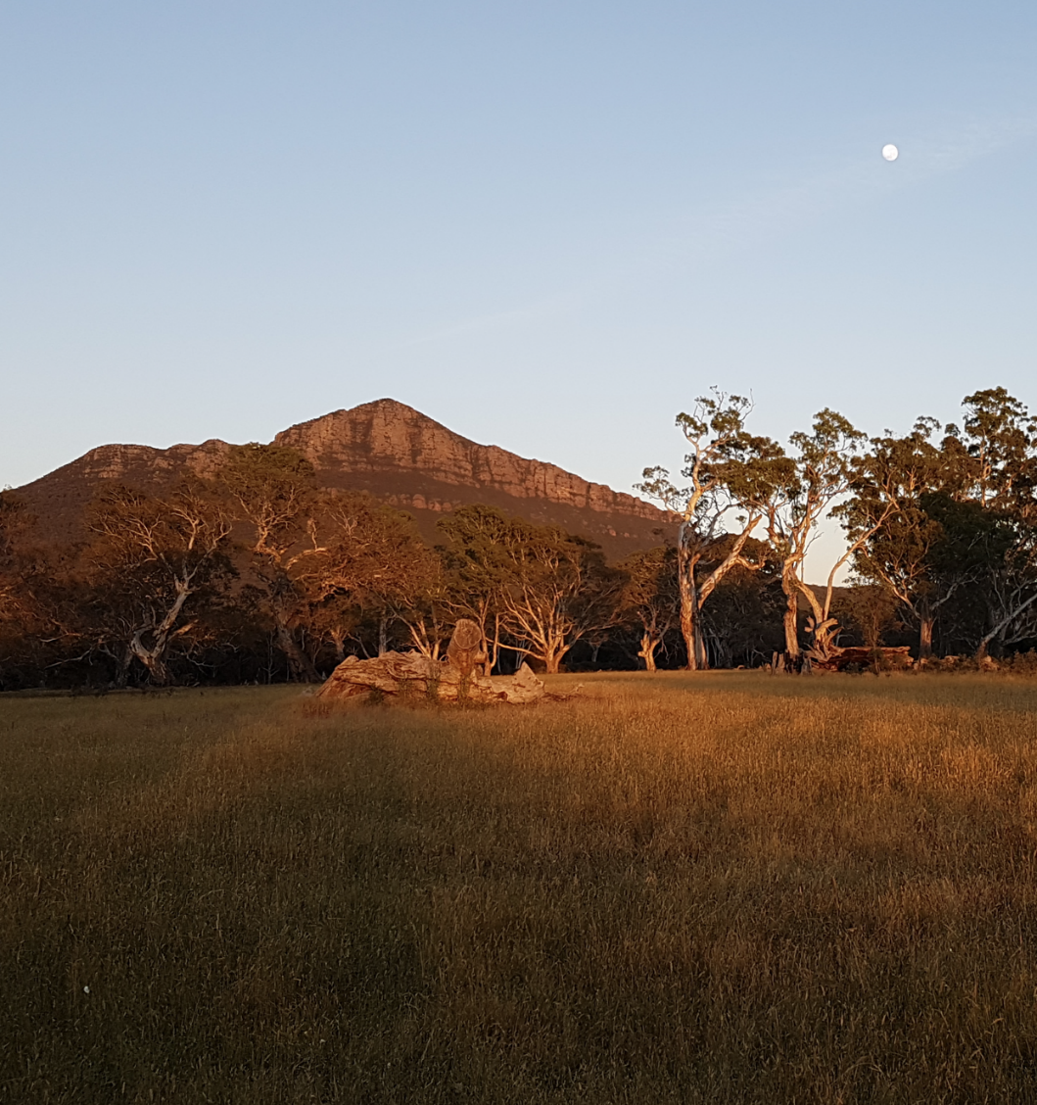



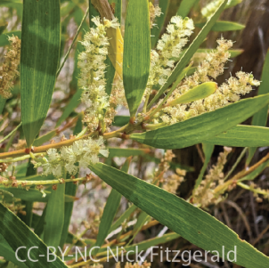


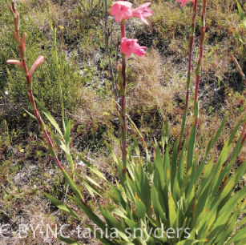


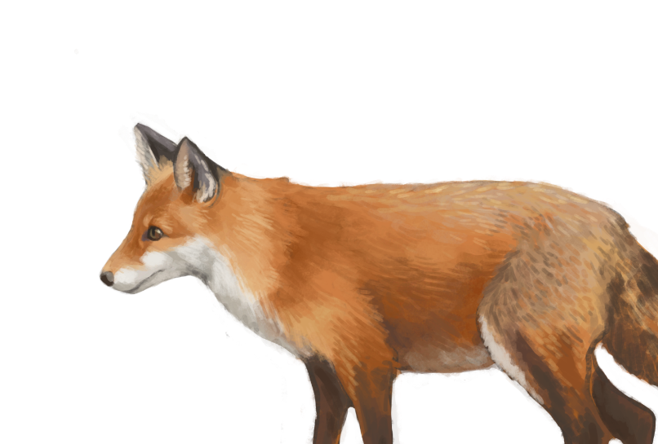

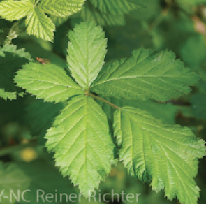
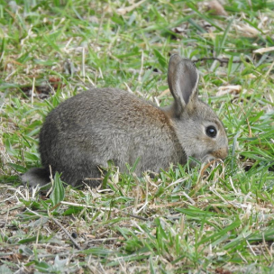
Guarding Gariwerd – Partnerships Against Pests
Initiated by a Landcare group
Opportunity to expand via Agriculture Victoria’s ‘Partnerships Against Pest Program’
Highly modified
Buffer
Reserves
Slides and images courtesy of Project Platypus

Slide 13












Guarding Gariwerd – Partnerships Against Pests Project Partners
Slides and images courtesy of Project Platypus

Slide 14
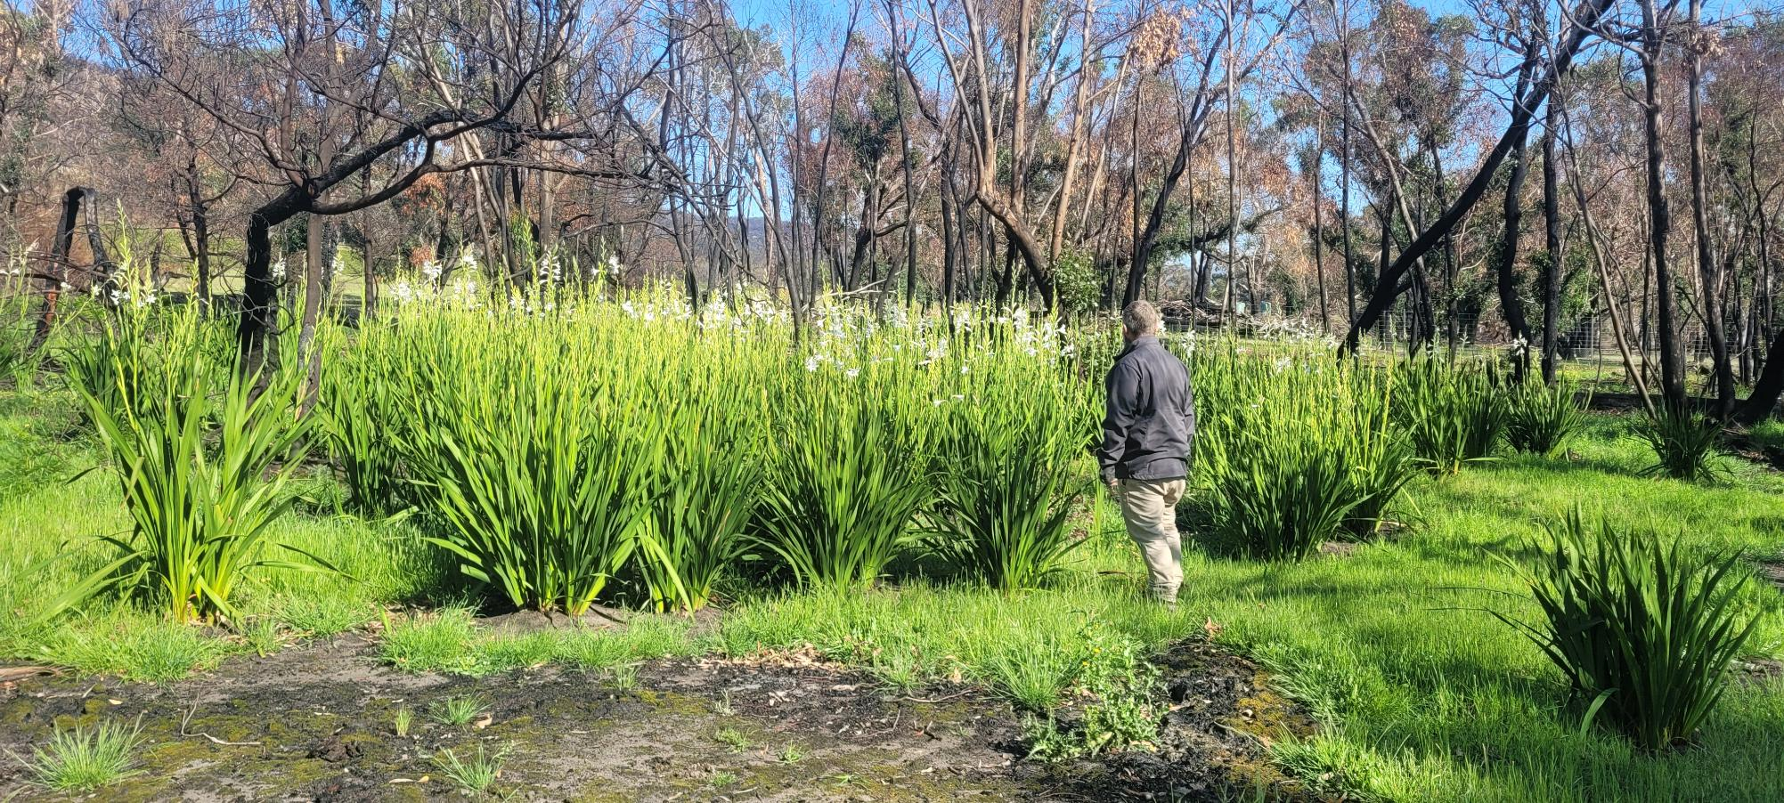
The importance of working in partnerships...
Private landholders control most of the land (84%!)
Private landholders have potential to notice things first
Alleviates budget and resource restraints for all
Scale of on-ground work often very large
We have a shared responsibility
Working together we will achieve a whole lot more.
Slides and images courtesy of Project Platypus

Slide 15
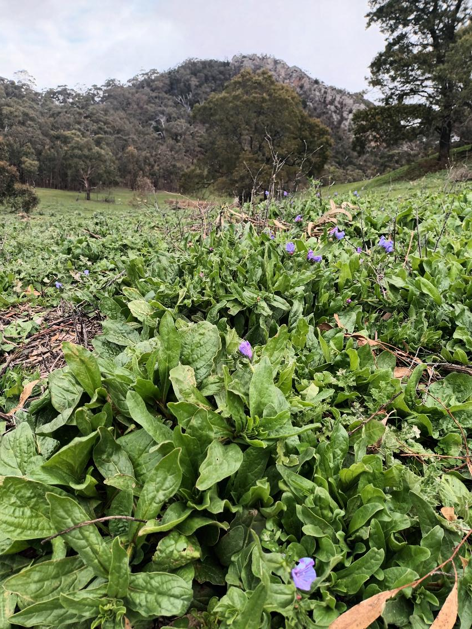
What have we been up to?
Wimmera Biodiversity Seminar Sep 2023 (GG project launch)
Landcare group priority plans (Halls Gap/Moyston/Jallukar/Black Range/Stawell)
Development of Fulcrum App (Centralised and easier data collection/reporting)
IPA management field demonstration days (Minyip/Pomonal/Laharum)
Locally tailored IPA ‘101 kits’ (Halls Gap/Jallukar/Moyston/Stawell/Minyip)
Meet the agencies workshops (Pomonal/Minyip/Laharum/Glenorchy/Halls Gap)
Subsidise training and accreditation (AQF3, 1080/PAPP, Weedstop)
Victorian Rabbit Action Network Bootcamp (Autumn 2026)
Slides and images courtesy of Project Platypus

Slide 16
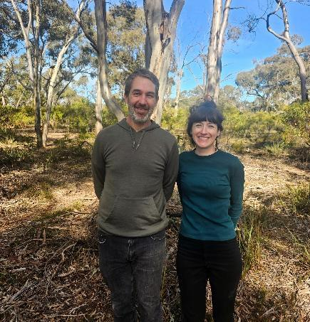
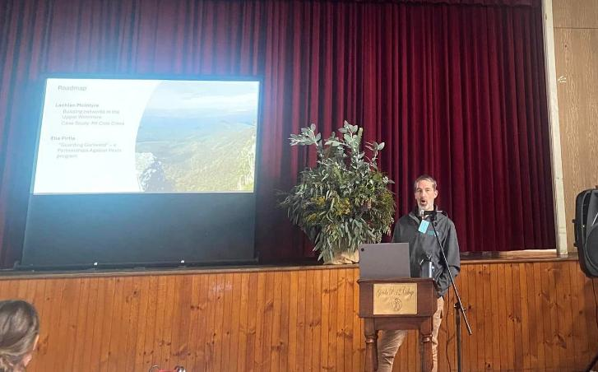
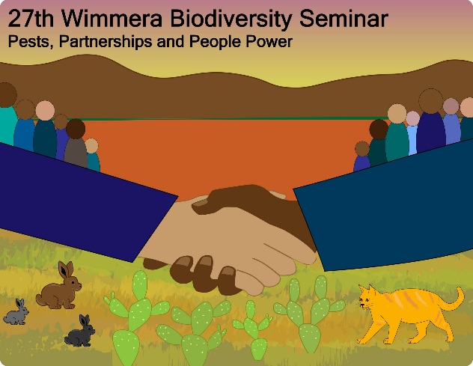
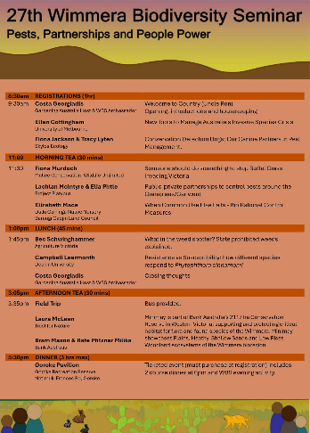
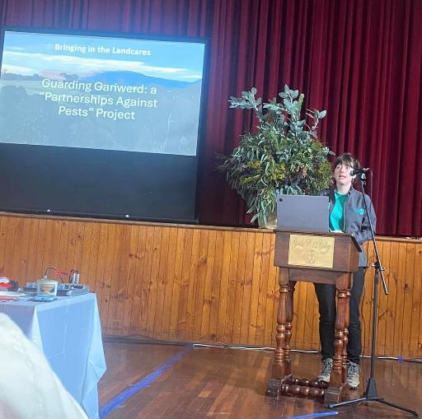
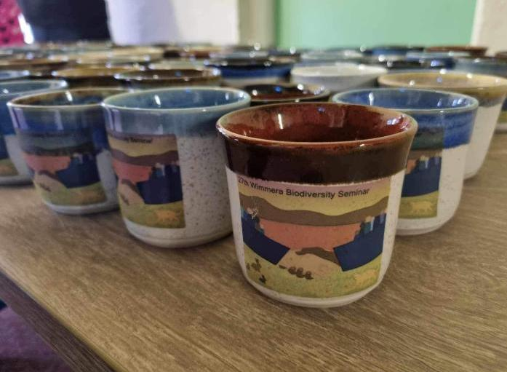
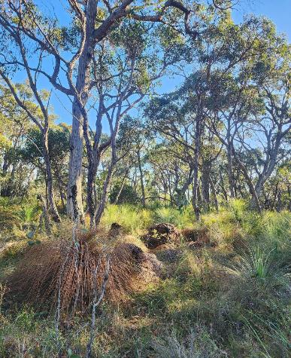
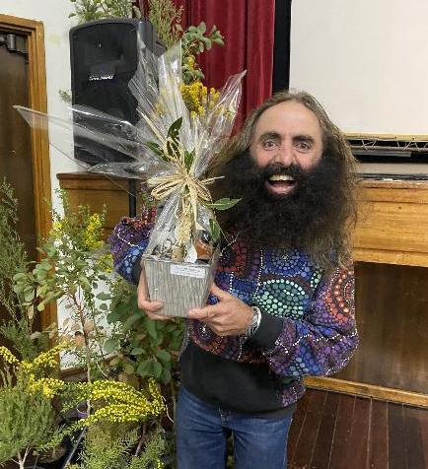
Wimmera Biodiversity Seminar project launch
Slides and images courtesy of Project Platypus

Slide 17
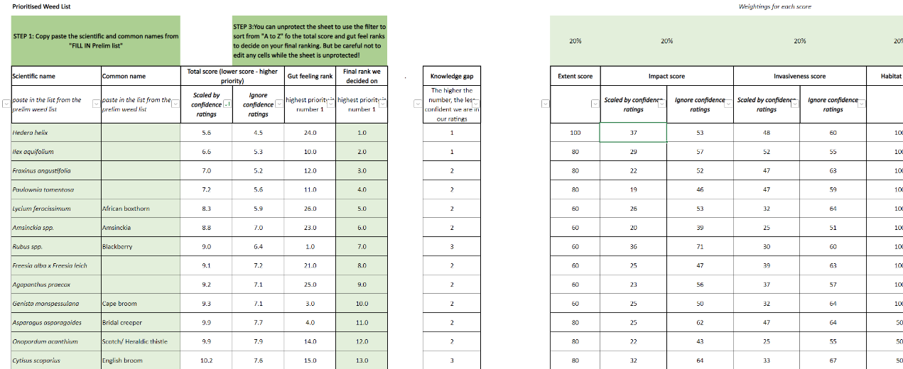
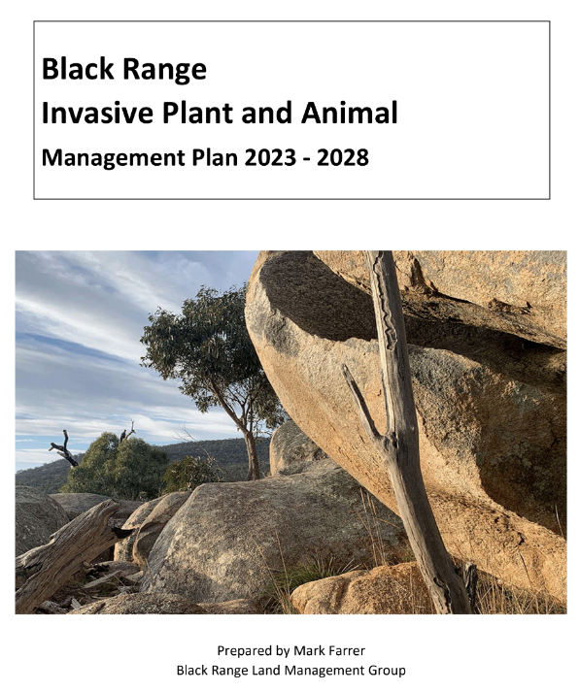
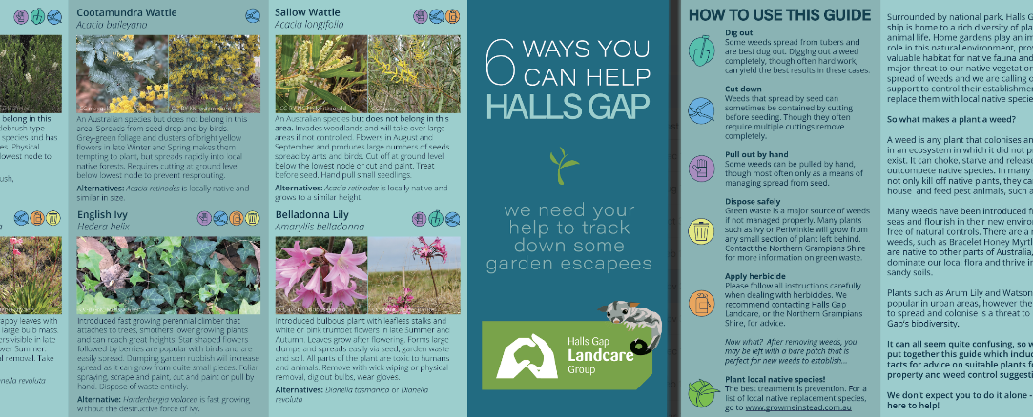
Landcare Priority Plans/Weed Prioritisation
Slides and images courtesy of Project Platypus

Slide 18
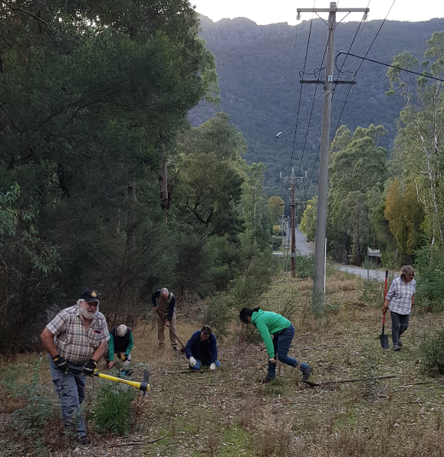
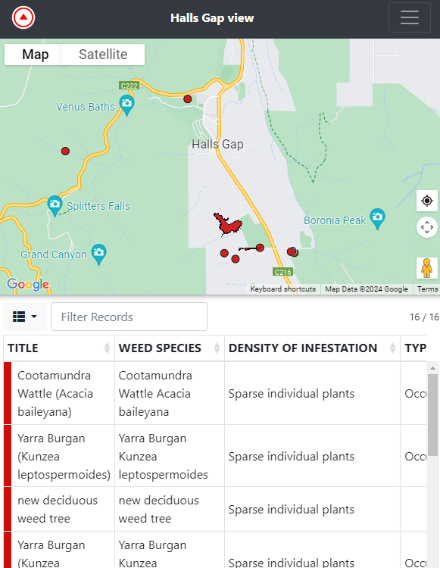
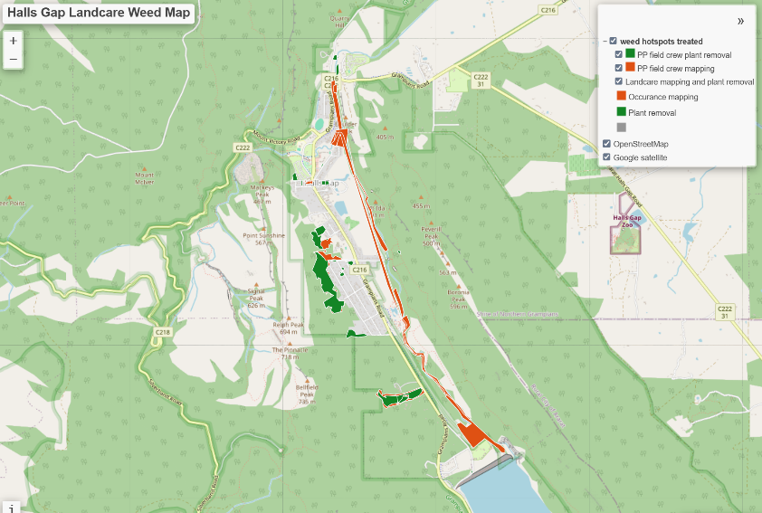
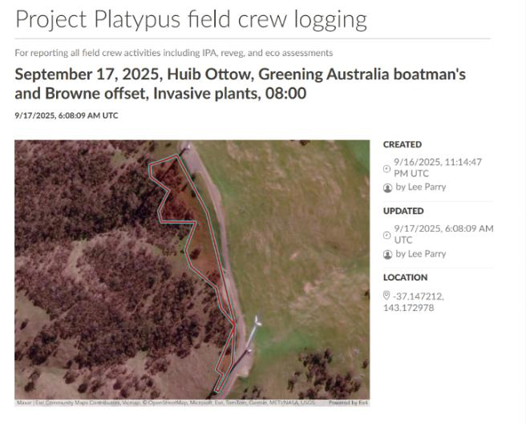

Fulcrum App development
Allows for easier mapping of activities/ species
Central location to store data
Easier access of data
Easier reporting
Allows for Landscape wide picture of activities
Slides and images courtesy of Project Platypus

Slide 19
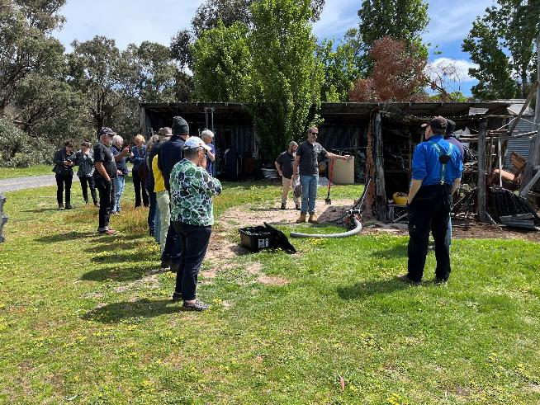
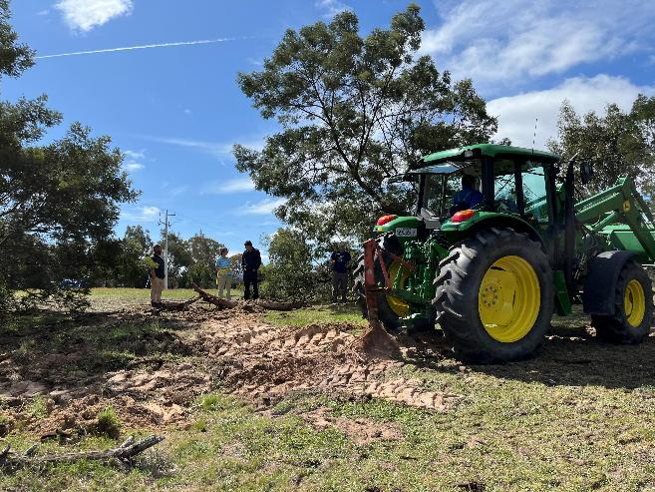
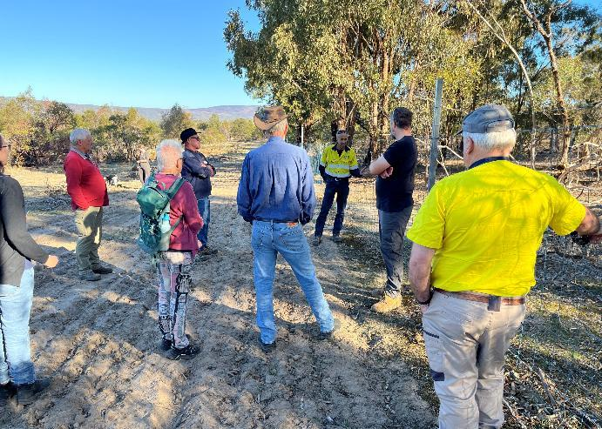
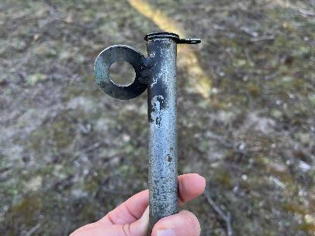
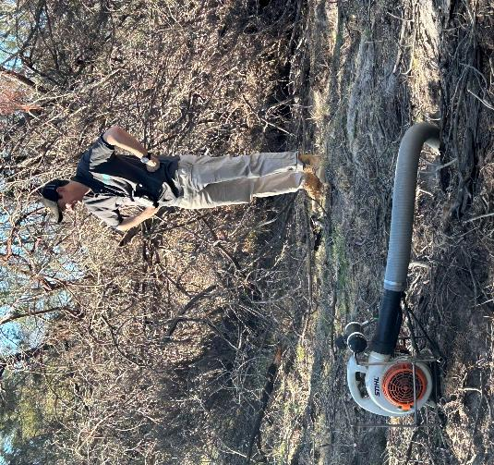
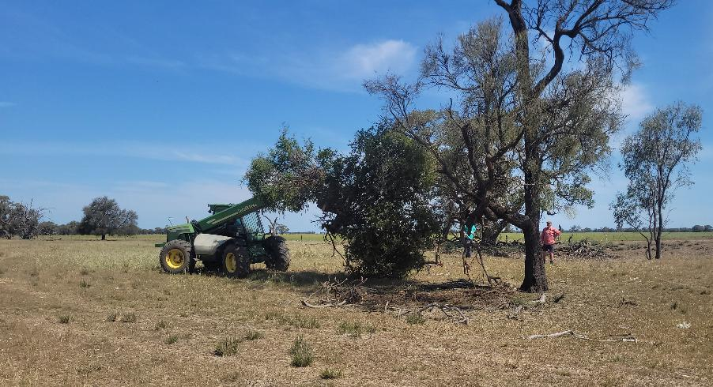
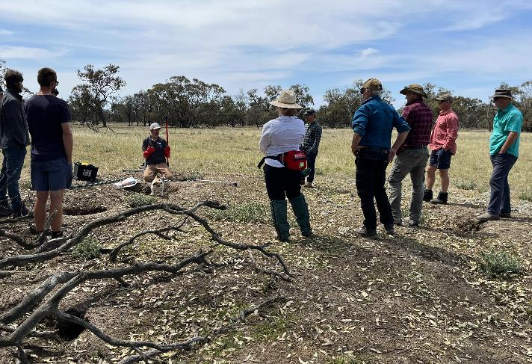
Field Demonstrations
Slides and images courtesy of Project Platypus

Slide 20







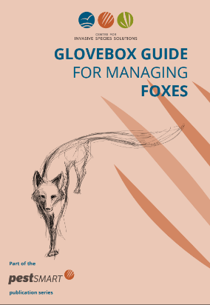
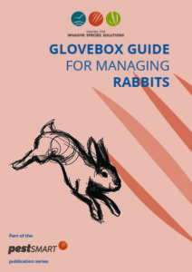
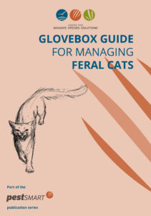
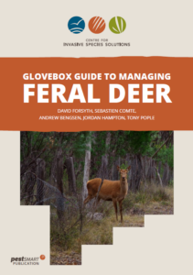

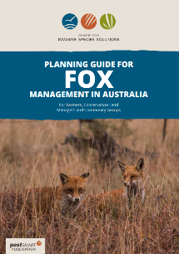
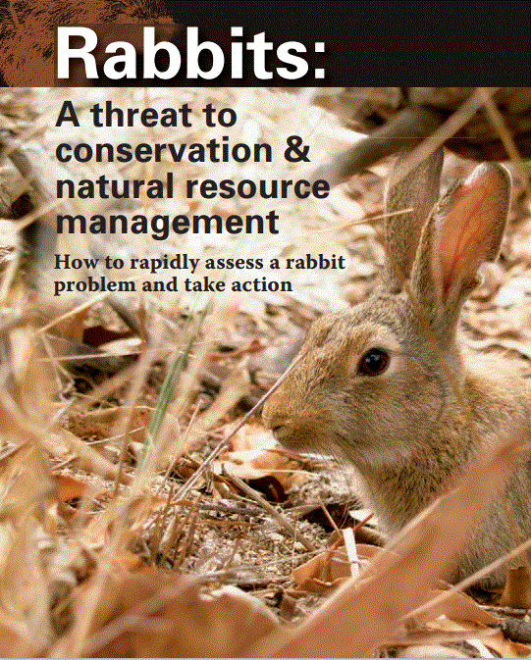
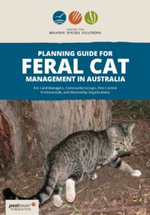

Locally tailored IPA kits
Community Pest Management Groups
Slides and images courtesy of Project Platypus

Slide 21
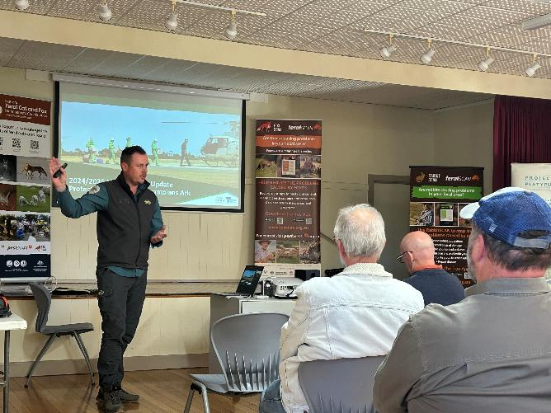
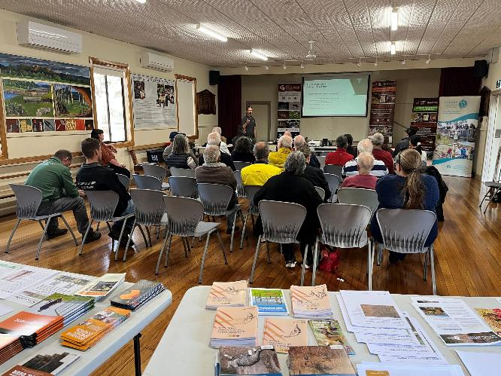
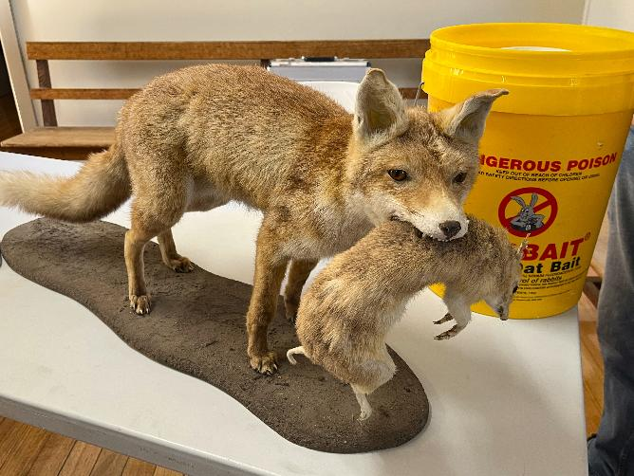
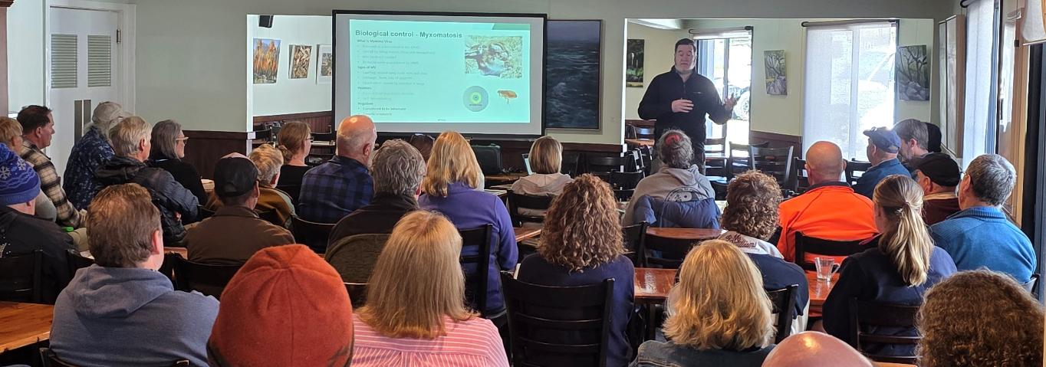

Meet the agencies
Slides and images courtesy of Project Platypus

Slide 22







Chemcert AQF3 (ACUP) + 1080/PAPP endorsement
Slides and images courtesy of Project Platypus

Slide 23







Vic Rabbit Action Network – Bootcamp/Leadership course (2026)
Slides and images courtesy of Project Platypus

Slide 24

Challenges in delivery...
Fires every 10-12 months in the project area (these seem to be an annual event!)
Loss of some critical community members
Working with absentee landholders
Silver's review and impact on agency staff/changing roles/secondments
Keeping stakeholders engaged – volume of work/changes in workforce/aligning priorities.
Slides and images courtesy of Project Platypus

Slide 25

Positive outcomes...
Stronger relations with Landcarers, groups and networks​
Stronger relations with agency staff with closer links to community groups​
Better understanding of the CaLP Act and ​
Better understanding of focus species and how to manage/control​
Landholders trained with relevant qualifications/licenses to initial control work ​
Greater understanding of CPMGs and other peak bodies/groups​
Increased involvement in the IPA committee​
Better understanding of funding for both private and public land managers​
Sharing of data and resources to make cross-tenure approach more likely​
Stronger partnerships between agencies and private land managers
Slides and images courtesy of Project Platypus

Slide 26

Where to from here?
Another round of grants to apply for (April 2026)
Further integration of mapping app into Landcare network
A few more weed prioritisation sessions with Landcare groups
More locally tailored resources/publications for Landcare groups
Better cross tenure engagement/collaboration between public and private landholders
Slides and images courtesy of Project Platypus

Slide 27
Partnerships Against Pests Round 5 Grants
Objectives
Assessment Criteria
Eligibility
Changes and Key Info
Activities and Outputs

Slide 28
Round 5 Funding
THE PRIMARY GOALS OF THE GRANTS PROGRAM ARE TO BOOST COMMUNITY PARTICIPATION AND IMPROVE THE CAPACITY OF LAND MANAGERS TO MANAGE ESTABLISHED WEEDS AND PEST ANIMALS ON THEIR LAND.
There is $600,000 in funding available in 2026-27 for projects focusing on community capacity building activities.
Streams | Eligible Organisations | Funding Objectives | Grant amount | Total funding
Stream 2 and Stream 1b | Regional and Local Level Organisations and The 4 recognised Community Pest Management Groups | A competitive application process for community-based organisations operating at statewide, regional or local levels with an interest in established invasive species management. | From $10,000 up to $50,000 (ex. GST) | $600,000

Slide 29





Grants Program Objectives
SOME INSPIRATION FOR FULFILLING THE OBJECTIVES FROM SUCCESSFUL APPLICATIONS
Capacity Building
TRAIN COMMUNITY TO USE TECHNOLOGY TO TARGET PESTS AND WEEDS, INCLUDING DRONES, FERALSCAN, WEEDSCAN
DEVELOP A PEST MANAGEMENT STRATEGY OR COMMUNITY MANAGEMENT PLAN
Strategic Planning
Capability Building
TRAIN COMMUNITY LEADERS AND KEY STAFF IN LEADERSHIP, RISK MANAGEMENT AND GROUP FACILITATION SKILLS
COLLABORATE WITH A RANGE OF STAKEHOLDERS AND CLEARLY DEFINE THEIR ROLES IN PROJECT DELIVERY
Partnerships
Agricultural Values
Raising Awareness
PRODUCE VIDEOS OF LOCAL CASE STUDIES TO SHARE KNOWLEDGE AND BUILD PEST MANAGEMENT CAPACITY
FACILITATED MEETINGS TO SUPPORT COORDINATED PEST MANAGEMENT AMONG LANDHOLDERS

Slide 30
Assessment Criteria and Weighting
Applicants must address the following assessment criteria:
Yes/No
Meets requirements and contains appropriate documentation
Alignment with objectives
50%
Aligning to and achieving Program objectives
Value for money
30%
Overall Value for Money
Innovation
10%
Innovation
10%
Organisational Capability and Capacity to deliver
Organisation

Slide 31
Group Eligibility
TO BE ELIGIBLE FOR ROUND 5, APPLICANTS MUST BE EITHER:
An incorporated association registered through Consumer Affairs Victoria.
OR
A registered company with the Australian Securities Investment Commission (ASIC).
OR
An Aboriginal and Torres Strait Islander corporation registered with the Office of the Registrar of Indigenous Corporations (ORIC) under the Corporations (Aboriginal and Torres Strait Islander) Act 2006.
AND
Hold sufficient insurance to safeguard volunteers and participants involved in the funded activities, including public liability insurance of at least $20 million and personal accident insurance, or have an auspice arrangement with a partner who meets the above requirements.

Slide 32



Key Information for Round 5
NEW FOR ROUND 5:
KEPT FROM ROUND 4:
Agricultural Land Values Objective:
Round 5 introduces a new objective designed to support activities that safeguard community-prioritised agricultural values and build resilience.
CPMG Support Requests:
Applicants seeking CPMG support MUST submit the online form outlining their request by
1 May 2026.
Auspicing:
Groups applying under the auspice of another organisation must complete and submit the PAP Auspice Agreement Form and with their application.
New Budget Process:
Groups MUST provide a budget summary in the online form AND submit an itemised project budget on the PAP Round 5 Budget template with their application.
Capital Item Funding:
Groups with 2+ years of demonstrated community engagement may apply for up to $10,000 in capital items.

Slide 33












Eligible Activities
FUNDING CAN ONLY BE USED FOR ITEMS DIRECTLY RELATED TO THE DELIVERY OF THE PROJECT
What may be funded?
NOT LIMITED TO
Consultants, facilitators and presenters
Resource materials
and consumable items
Project management and administration costs capped at 15%
Capital items up to $3,000
OR Groups with 2+ years’ sustained community engagement may access up to $10,000 in capital items
Project officer time to deliver measurable project activities
Website and app development
Advertising, printing, design, and postage
Training or educational course fees
Photography, videography and video production
Transport and travel within Victoria for project delivery
Publicity, communications, and marketing
Hire of equipment and venues for events
Food and non-alcoholic beverages – e.g. light event catering.

Slide 34
Potential Outputs
You will be asked to specify the number and type of outputs your group intends to complete as part of your project.
Output Type | Example | Output Type | Example
Advertising | Road signs, print or online promotion of events | Online event | Webinar
Assessment/Survey | Post activity evaluation | Plan/Strategy | Group plan or strategy for 1 or more species
Capital Item Demonstration | Appropriate use of a capital item purchased with this grant, e.g. rabbit bait layer | Presentation | Stakeholder event with subject matter expert led presentation
Communications | Social media posts, newsletters, website upgrades | Publications | Fact sheets, resource documents, newspaper or journal article
Cultural Heritage Activity | Traditional owner led training, workshop or on-country learning | Research | Research activity with direct community involvement
Engagement Activity | Stand/stall at an event, e.g. Elmore Field days, local market, to engage with interested parties | Seminar/Conference/Expo | Formal gathering addressing multiple topics, e.g. present research findings, case studies
Field day | Farm walk and discussion/presentation | Training event | Formal training e.g. VRAN bootcamp, AgVet Chemical Course
Mapping | Weed or pest animal mapping, e.g. using WeedScan/FeralScan | Video/Audio production | YouTube video, TV ad or podcast
Meeting | Stakeholder or planning meeting | Workshop | Discussion and practical demonstrations
If your activity does not fit into any of the above categories, please describe it in the ‘other’ section of the application form.

Slide 35
Partnerships Against Pests Application and Examples
Preparing your Application
Budget Template
Lessons from Successful Applicants
Application Process
Funding Distribution

Slide 36








Preparing a Strong Application
APPLICATION KEY INCLUSIONS:
ASSESSMENT CRITERIA
Explain how your project addresses the objectives and outcomes of the PAP Program
BUDGET
An itemised project budget, including costings and any other sources of funding
TARGET SPECIES
A list of the species declared under the Catchment and Land Protection Act 1994 the project targets
PARTNERSHIPS
A list of your partners and collaborators, including CPMGs
and Traditional Owner Corporations
IN-KIND CONTRIBUTIONS
Details of in-kind contributions from your group and partners, such as volunteer time or resources
OUTPUTS
Estimates of the type and quantity of activities to be delivered by the project
LETTERS OF SUPPORT
Written confirmation of the type of support and level of investment from all major project partners
CAPITAL ITEMS OVER $3,000
Detail what equipment you want, how it will help your group and how it will be maintained after the project
BEST PRACTICE MANAGEMENT
Deliver management information that is considered by Agriculture Victoria as best practice for the target species

Slide 37

Budget Template
BUDGET SECTION HAS BEEN UPDATED TO MAKE IT CLEARER FOR APPLICANTS AND ASSESSORS

Slide 38

Budget Form
BUDGET SECTION OF THE APPLICATION FORM NOW HAS 3 BOXES TO COMPLETE
Amount requested from this Program
Total value of in-kind contributions for this project.
Total value of any other income, grants or contributions relating to this project.
Total project value

Slide 39







Lessons from Successful Applicants
CONSIDERATIONS FOR PLANNING YOUR PROJECT
 | Face-to-face events show consistently higher levels of community engagement than virtual ones
 | Allow sufficient time to recruit a project officer
 | Budget realistically – event logistics often involve hidden or underestimated costs
 | Maximise attendance by scheduling activities around community availability
 | Access to expertise and presenters
 | Ensure your project partners have the time and capacity to actively contribute

Slide 40

Application Process
Visit the Agriculture Victoria website and download the Round 5 Guidelines
Check your group is eligible
Review the objectives and outcomes
Select your target species and focus area
Develop project proposal, budget and timeline
Log into or create a Grants Online account
Confirm partnerships with written support
Contact your local Engagement Officer
CPMG contact deadline: Friday 1 May 2026
Prepare
your application and letters of support
Finalise application and upload documents
Submit by 11:59PM on 11 May 2026

Slide 41
Funding Distribution
funding distribution is dependent ON milestone completion
Milestone 1:
Grant Agreement is executed when both parties have signed off
90% of approved project funding
Milestone 2:
Mid-Project report – due 6 months into project
10% of approved project funding
Milestone 3:
Final report submitted – due 1 month after project finishes
Note – failure to submit a final report will render A group ineligible for further DEECA funding until any outstanding components of a grant agreement are completed.

Slide 42
Wrap up
Q&A
Resources

Slide 43


Questions and Resources
PLEASE ACCESS THE Q&A BY CLICKING THE ICON AT THE TOP OF THE WINDOW
Further information is available on the Agriculture Victoria website, particularly the following pages:
Partnerships Against Pests Program
The Grants Program
Round 5 Guidelines
Key Dates for Round 5
CPMG Contact Deadline | 1 May 2026
Applications Close | 11:59pm Monday 11 May 2026
Successful Projects Announced | After 10 August 2026
Project Activities Completed | 17 September 2027
Final Reports Submitted | 15 October 2027
Contacts – including the Partnerships Against Pests grants team, Regional Engagement Officers and Grants Online support

Slide 44
Thank you

