Slide 1
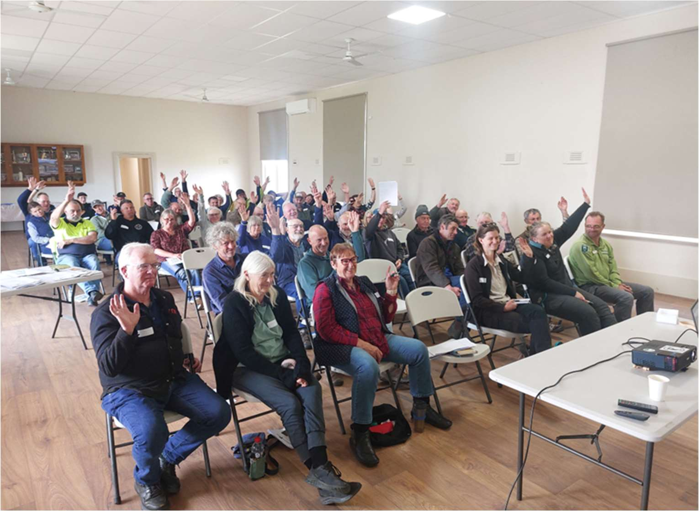
Partnerships Against Pests Grants Program Round 4
Webinar – 23 May 2025

Slide 2

Acknowledgement of Country
We acknowledge and respect the Victorian Traditional Owners as the original custodians of Victoria’s land and water, their unique ability to care for Country and deep spiritual connection to it.
We honour Elders past and present whose knowledge and wisdom has ensured the continuation of culture and traditional practices.
DEECA is committed to genuinely partnering with Victorian Traditional Owners and Victoria’s community to progress their aspirations.

Slide 3



Housekeeping
This session is being recorded
The recording, transcript and slides will be available on the Partnerships Against Pests Grant Program website
Cameras, microphones and chat function are turned off
Questions can be asked via the Q&A icon at the top of the screen
Questions will be moderated and can be lodged anonymously

Slide 4
Agenda
1
Introduction & overview of the Partnerships Against Pests Program
The Program
The Grants
Stream 2 recipients, activities and feedback
2
Partnerships Against Pests Grants Program Round 4
Objectives
Changes for Round 4
Criteria
Eligibility
3
Applying for a Stream 2 Partnerships Against Pests Grant
Application process
Budgets and funding
Potential outputs
Learnings from previous applicants
4
Wrap up
Q&A
Resources
Thank you

Slide 5
Introduction & Overview of the Partnerships Against Pests Program
The Program
The Grants

Slide 6

Partnerships Against Pests Program
THE PARTNERSHIPS AGAINST PESTS PROGRAM IS AIMED AT EXPANDING COLLABORATIVE PARTNERSHIPS IN THE LONG-TERM MANAGEMENT OF ESTABLISHED WEEDS AND PEST ANIMALS IN VICTORIA.
THE PROGRAM FOCUSES ON SHARED RESPONSIBILITY AND A COMMUNITY-LED APPROACH TO MANAGING ESTABLISHED WEEDS AND PEST ANIMALS.
This program helps Agriculture Victoria to achieve Priority Action #13 from the Strategy:
Promote and support community led, place-based action on established weeds and pests.
Impacts of established weeds and pest animals on our landscapes and communities include:
substantial farm production losses
degradation of our ecosystems
damage to culturally sensitive sites of Victoria’s First Nations people
risking access to international agriculture markets
A 2023 ABARES study estimated that the annual cost of management and lost production to Victoria’s agricultural landowners due to established weeds and pest animals, is $869 million.
This aligns directly with Strategic Goal 4 in Victoria’s Biosecurity Strategy.
Goal 4 Management
Reduce the impacts of established weeds and pests through local action Management outlines the priorities for supporting local collective action on established weeds and pests and bringing together all the participants to achieve sustainable, long-term, whole-of-landscape changes.

Slide 7
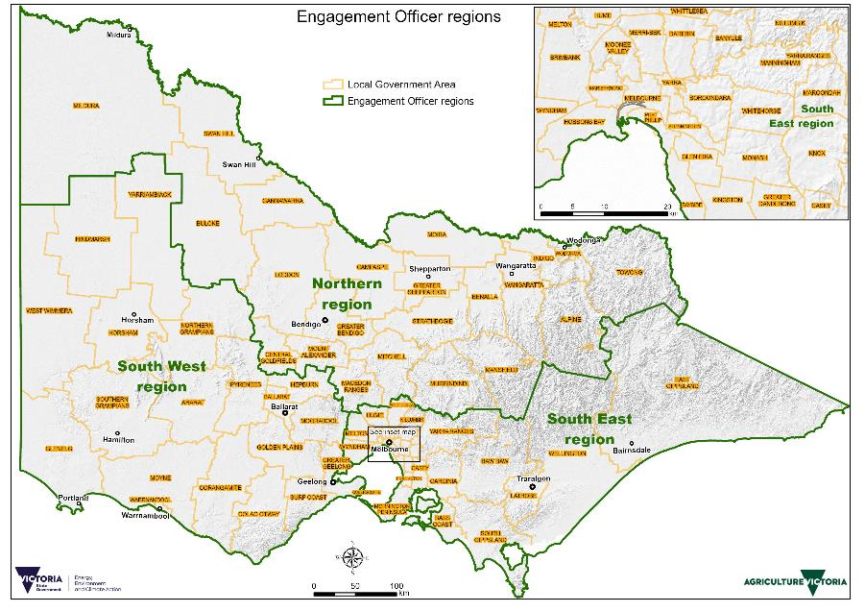




Partnerships Against Pests Program
THE PARTNERSHIPS AGAINST PESTS PROGRAM AIMS TO IMPROVE AND STRENGTHEN THE ESTABLISHED INVASIVES MANAGEMENT SYSTEM BY:
Funding AgVic Engagement Officers to support community groups.
Funding and supporting Victoria’s 4 Community Pest Management Groups (CPMGs)
Alastair Campbell
David Blythe
Katie Robinson

Slide 8

Grants Funding Streams
THE PRIMARY AIMS OF THE GRANTS PROGRAM ARE TO BOOST COMMUNITY PARTICIPATION AND IMPROVE THE CAPACITY OF LAND MANAGERS TO MANAGE ESTABLISHED WEEDS AND PEST ANIMALS ON THEIR LAND.
There is $637,000 in funding available in Stream 2 in 2025-26 for projects focusing on community capacity building activities.
Stream | Eligible Organisations | Funding Objectives | Grant amount | Total funding
Stream 2 | Regional and Local Level Organisations | A competitive application process for community-based organisations operating at a local or regional level with an interest in established invasive species management. | From $10,000 up to $50,000 (ex. GST) | $637,000

Slide 9
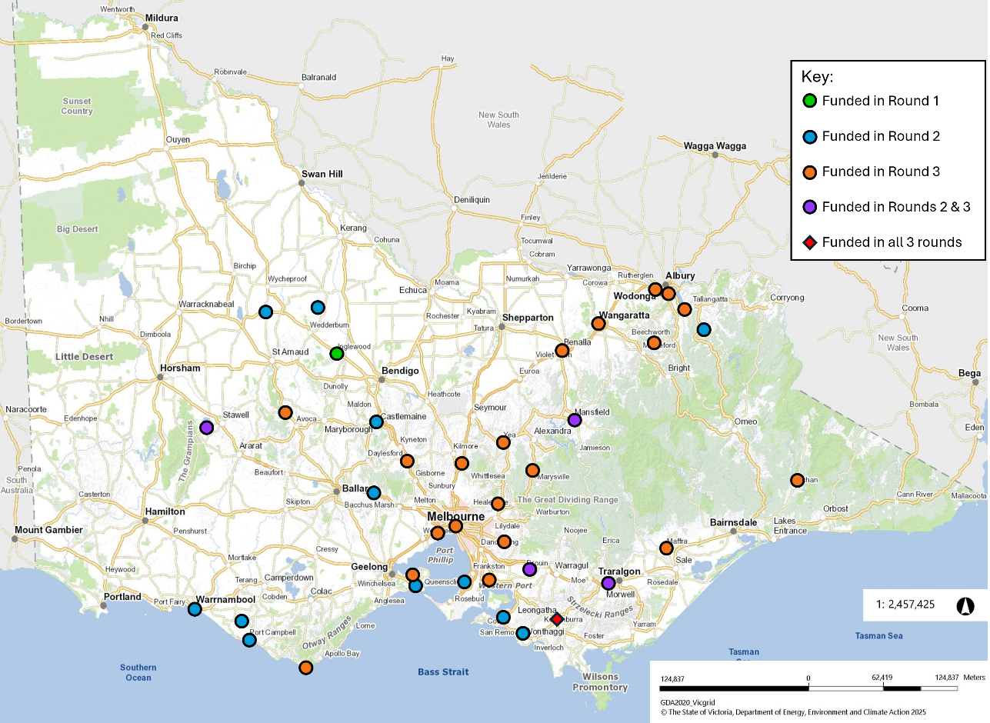
Stream 2 Recipients
SINCE 2023, THE PARTNERSHIPS AGAINST PESTS GRANTS PROGRAM HAS FUNDED 43 PROJECTS RUN BY 37 GROUPS.
Key:
Funded in Round 1
Funded in Round 2
Funded in Round 3
Funded in Rounds 2 & 3
Funded in all Rounds
Pilot round – 2 projects
Round 2 – 16 projects
Round 3 – 25 projects

Slide 10
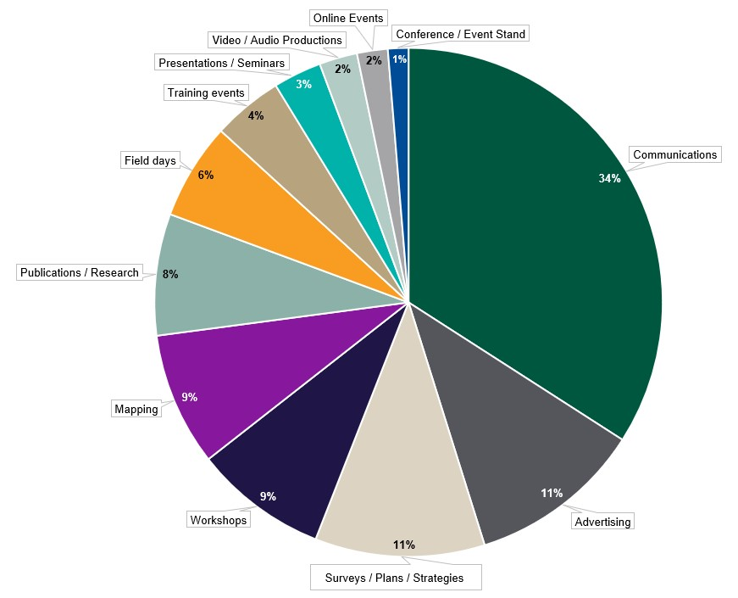
Stream 2 Summary
STREAM 2 OF THE PARTNERSHIPS AGAINST PESTS GRANTS PROGRAM HAS DELIVERED NEARLY $1.5 MILLION IN FUNDING.
The 43 funded projects have planned or completed 1272 outputs and activities, including:
66 field days
48 training events
91 workshops
26 videos

Slide 11

Round 3 Funded Project
GUARDING GARIWERD ROUND 2:
EMPOWERING COMMUNITY TO CONTROL PRIORITY PESTS
Aims
Activities
Build community capacity in chemical handling, biosecurity and pest animal control.
Use digital mapping tool (Fulcrum) to map invasive species, consistently record on-ground activities and share data with partner agencies.
Build and maintain strong, collaborative partnerships between Landcare, Government, VRAN, CMAs and TOCs to promote coordinated regional action.
Partners
Training chemical handling and vehicle hygiene for biosecurity
Host a VRAN bootcamp
Develop local ‘Top 10 Priority Pests’ pamphlets for 11 Landcare Groups.
Expand use of the Fulcrum app from pilot group to all Landcare groups in the project region.
Develop a Community of Practice model for field data collection.
Yarrilinks, West Wimmera, and Hindmarsh Landcare Networks
Wimmera Catchment Management Authority
Northern Grampians Shire Council
DEECA and Parks Victoria
Centre for Invasive Species Solutions
Trust for Nature

Slide 12
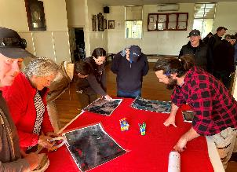
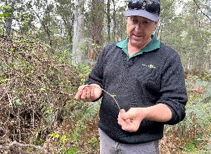

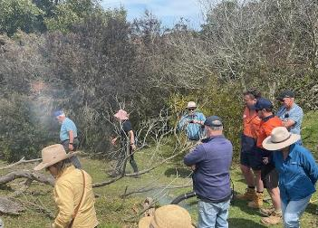
Stream 2 Feedback
The wheel cactus control work at Buckrabunyule has not gone unnoticed by local landholders.
The PAP program has been invaluable for kickstarting our Pest and Weed management efforts on a Landscape Scale.
Communication and collaboration between partner organisations has furthered our collective understanding of how different organisations and agencies address established invasive species management, improving are ability to work together going forward.
We ran targeted ads to boost our reach for the project and in doing so we have learnt more about how to run these ads successfully. We had a much higher reach in our second round of promotion.
The community has been interested in weed management, and in Landcare more broadly.
We have seen an uptake in membership.

Slide 13
Partnerships Against Pests Round 4
Objectives
Changes to Round 4
Criteria
Eligibility

Slide 14




Program Objectives
SOME INSPIRATION FULFILLING THE OBJECTIVES FROM SUCCESSFUL APPLICATIONS
Capacity Building
TRAINING COMMUNITY TO USE TECHNOLOGY TO TARGET PESTS AND WEEDS, INCLUDING FERALSCAN, WEEDSCAN, DRONES
Strategic Planning
DEVELOPMENT OF A STRATEGY OR COMMUNITY MANAGEMENT PLAN
Capability Building
Partnership & Collaboration
DELIVER TRAINING SESSIONS WITH COMMUNITY LEADERS AND KEY EMPLOYEES AROUND RISK MANAGEMENT, LEADERSHIP AND GROUP FACILITATION SKILLS​
PARTNER WITH A RANGE OF STAKEHOLDERS WITH
CLEARLY DEFINED ROLES IN PROJECT DELIVERY
Raising Awareness
Partnership & Collaboration
VIDEO PRODUCTIONS ON LOCAL CASE STUDIES TO SHARE KNOWLEDGE & BUILD MANAGEMENT CAPACITY
WORKING WITH TRADITIONAL OWNERS TO IDENTIFY WEEDS THREATENING CULTURAL VALUES AND HERITAGE​

Slide 15


Changes for Round 4
THE FOLLOWING CHANGES HAVE BEEN MADE FOR THE NEW ROUND OF GRANTS:
To request support from a Community Pest Management Group, applicants MUST submit an online proforma with the nature of their request by 10 June 2025. | Groups submitting their application under the auspice of another organisation MUST complete the PAP Auspice Agreement Form and attach it to their application. | Adjusted assessment criteria weighting: Increase the weighting of the value for money component Decrease the weighting of the project and output innovation component. | Groups who can demonstrate sustained community engagement over at least 2 years can now apply for up to $10,000 worth of capital items.
Requesting Support from CPMGs
Increase in the value limit of capital items

Slide 16

Assessment Criteria and Weighting
Stream 2 Applicants must address the following 5 assessment criteria:
Yes/No
Meets requirements and contains appropriate documentation
Alignment with objectives
50%
Aligning to and achieving Program objectives
30%
Overall Value for Money
Value for money
10%
Innovation
Innovation
10%
Organisational Capability and Capacity to deliver
Organisation

Slide 17

Group Eligibility
TO BE ELIGIBLE FOR STREAM 2, APPLICANTS MUST BE EITHER:
An incorporated association registered through Consumer Affairs Victoria.
OR
A registered company with the Australian Securities Investment Commission (ASIC).
OR
An Aboriginal and Torres Strait Islander corporation registered with the Office of the Registrar of Indigenous Corporations (ORIC) under the Corporations (Aboriginal and Torres Strait Islander) Act 2006.
AND
Hold sufficient insurance to safeguard volunteers and participants involved in the funded activities, including public liability insurance of at least $20 million and personal accident insurance, or have an auspice arrangement with a partner who meets the above requirements.

Slide 18
Funding Eligibility
FUNDING CAN ONLY BE USED FOR ITEMS DIRECTLY RELATED TO THE DELIVERY OF THE PROJECT
What may be funded?
Including but not limited to:
Consultants, facilitators and/or presenters.
Project officers time to deliver tangible and quantifiable project activities.
Training and/or educational course fees.
Publicity, communications, and marketing.
Advertising, printing, design, and postage.
Website and app development.
Photography, videography and video production.
Hire of equipment and venues for events.
Resource materials and consumable items.
Transport and travel within Victoria required for project delivery.
Food and non-alcoholic beverages within reason – for example: light event catering.
Capital items and equipment including monitoring technology, spray equipment or traps up to the value of $3,000.
In cases where the applicant can demonstrate sustained community engagement over a minimum of 2 years, they may apply to purchase capital items with a value up to $10,000.
Project management and administration costs that do not exceed 15% of the total funding requested.

Slide 19
Partnerships Against Pests Applications and Examples
Preparing your Application
How to Apply
Funding Distribution
Learnings from Previous Applicants
Notes:
Image credit: Kirsten Morrison

Slide 20






Preparing your Application
APPLICATIONS SHOULD INCLUDE:
ASSESSMENT CRITERIA
An explanation of how your project addresses the objectives and outcomes of the Program
IN-KIND CONTRIBUTIONS
Details of in-kind contributions from your group and partners, such as volunteer time or resources
PARTNERSHIPS
A list of your partners and collaborators, including CPMGs and Traditional Owner Corporations
TARGET SPECIES
A list of the species declared under the Catchment and Land Protection Act 1994 the project targets
LETTERS OF SUPPORT
Written confirmation of the type of support and level of investment from all major project partners
CAPITAL ITEMS OVER $3,000
Details of how the item will help your group and how you will maintain the equipment
BUDGET
A detailed breakdown of the costs involved in delivering the project, including the amount and source of any other funding
OUTPUTS
Estimates of the type and quantity of activities to be delivered by the project

Slide 21
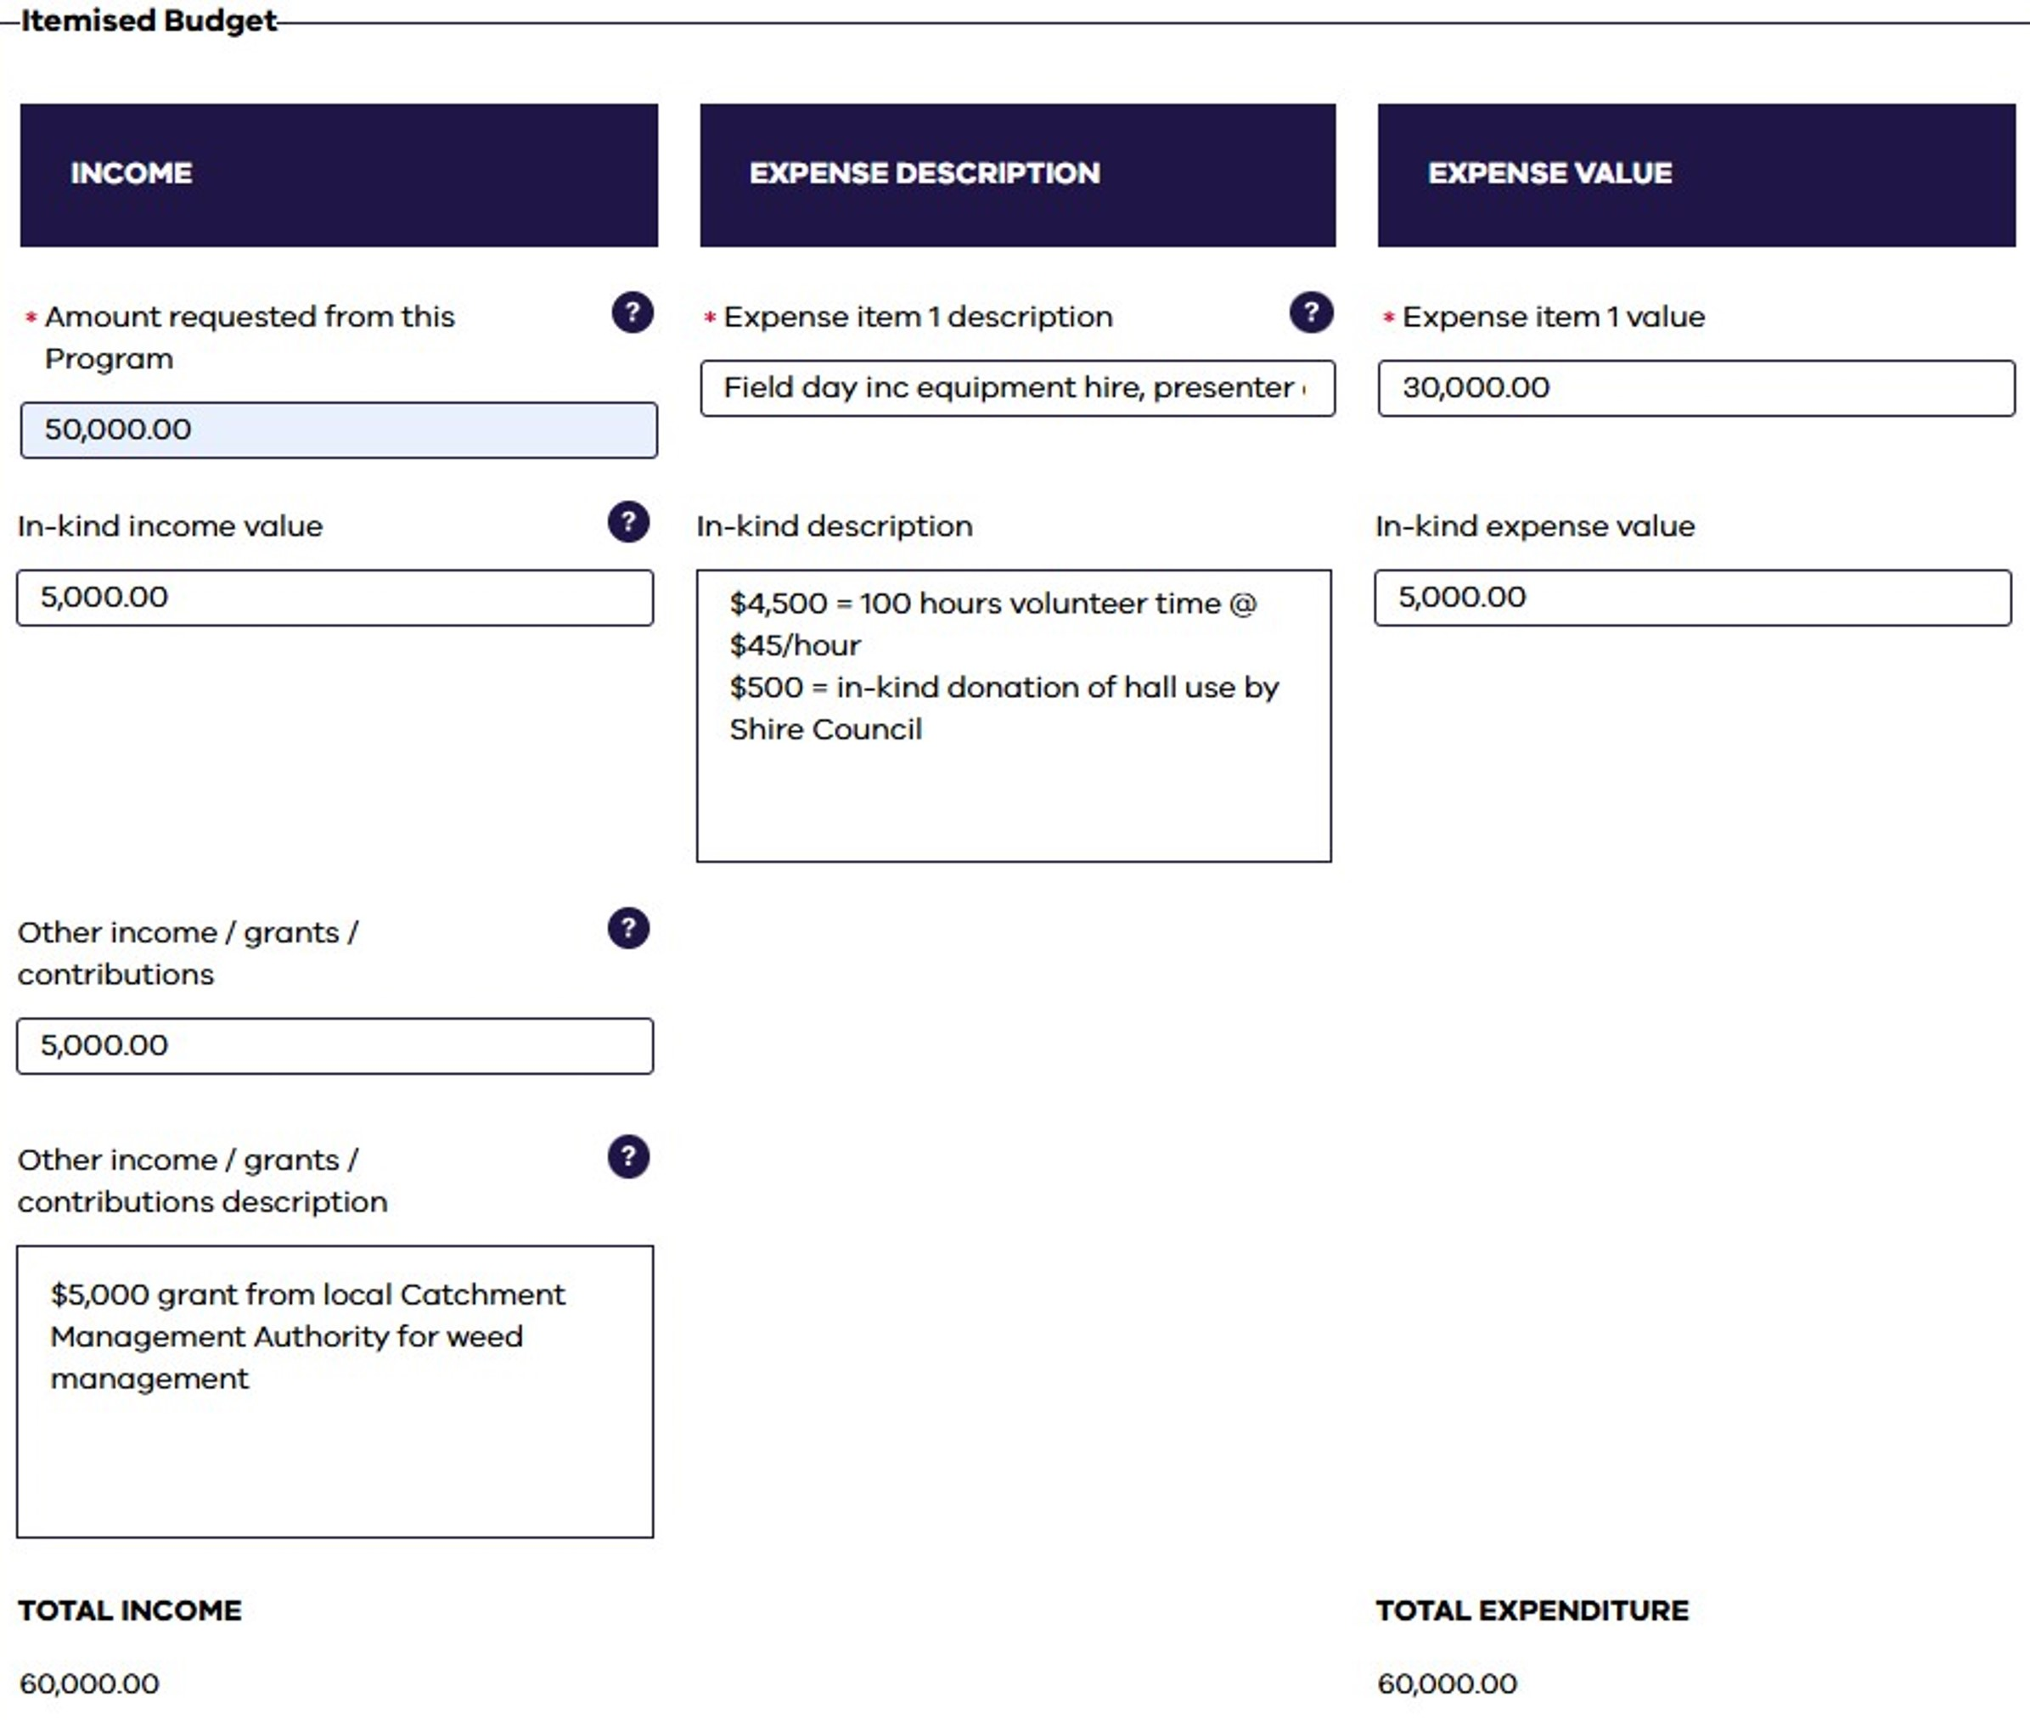
Budget Form
BUDGET SECTION HAS BEEN UPDATED TO MAKE IT CLEARER FOR APPLICANTS AND ASSESSORS.
3 kinds of income:
Amount requested from this grant program
In-kind income value
Other funding value
Expense description and value:
Short summary of each output and the total value of the activity
THE FORM WILL NOT ALLOW YOU TO MOVE ON IF THE TOTAL INCOME AND EXPENDITURE COLUMNS DO NOT MATCH.

Slide 22
Potential Outputs
You will be asked to specify the number and type of outputs your group intends to complete as part of your project.
Output Type | Example | Output Type | Example
Advertising | Road signs, print or online promotion of events | Online event | Webinar
Assessment/Survey | Post activity evaluation | Plan/Strategy | Group plan or strategy for 1 or more species
Capital Item Demonstration | Appropriate use of a capital item purchased with this grant, e.g. rabbit bait layer | Presentation | Stakeholder event with subject matter expert led presentation
Communications | Social media posts, newsletters, website upgrades | Publications | Fact sheets, resource documents, newspaper or journal article
Cultural Heritage Activity | Traditional owner led training, workshop or on-country learning | Research | Research activity with direct community involvement
Engagement Activity | Stand/stall at an event, e.g. Elmore Field days, local market, to engage with interested parties | Seminar/Conference/Expo | Formal gathering addressing multiple topics, e.g. present research findings, case studies
Field day | Farm walk and discussion/presentation | Training event | Formal training e.g. VRAN bootcamp, AgVet Chemical Course
Mapping | Weed or pest animal mapping, e.g. using WeedScan/FeralScan | Video/Audio production | YouTube video, TV ad or podcast
Meeting | Stakeholder or planning meeting | Workshop | Discussion and practical demonstrations
If your activity does not fit into any of the above categories, please describe it in the ‘other’ section of the application form.

Slide 23

How to Apply
Visit the Agriculture Victoria website and download the Guidelines
Check your group is eligible
Review the objectives and outcomes
Select your target species and focus area
Contact your local Engagement Officer
Develop project proposal, budget and timeline
Create a Grants Online account
Confirm partnerships with written support
Deadline to contact the CPMGs: 10 June 2025
Prepare
your application and letters of support
Finalise application and upload documents
Submit by
4 July 2025!

Slide 24
Funding Distribution
funding distribution is dependent on the project duration and milestone completion
One Year Projects
Milestone 1:
Execution of Grant Agreement
Milestone 2:
Mid-Project report
Milestone 3:
Final report
90% of approved project funding
10% of approved project funding
TWO Year Projects
Milestone 1:
Execution of Grant Agreement
Milestone 2:
Mid-project report
Milestone 3:
Progress report
Milestone 4:
Final report
100% of approved Year 1 project funding
90% of approved Year 2 project funding
10% of approved Year 2 project funding
Note – failure to submit a final report will render A group ineligible for further funding until any outstanding components of a grant agreement are completed.

Slide 25





Learnings from Previous Applicants
SOME KEY CONSIDERATIONS WHEN PLANNING YOUR PROJECT
 | Time to recruit a project officer
 | Underestimation of costs (including hidden costs in the logistics of events)
 | Planning events to fit in with the community's schedule
 | Access to expertise and presenters
 | Enough capacity from collaborators to be involved

Slide 26
Wrap up
Q&A
Resources

Slide 27


Questions
PLEASE ACCESS THE Q&A BY CLICKING THE ICON AT THE TOP OF THE WINDOW
Further information is available on the Agriculture Victoria website, particularly the following pages:
Partnerships Against Pests Program
The Grants Program
Round 4 Stream 2 Guidelines
Key Dates for Stream 2
CPMG Contact Deadline | 10 June 2025
Applications Close | 11:59pm Friday 4 July 2025
Successful Projects Announced | After 29 September 2025
 | 12 Month Projects | 24 Month Projects
Project Activities Completed | 6 November 2026 | 5 November 2027
Final Reports Submitted | 11 December 2026 | 10 December 2027
Contacts – including the Partnerships Against Pests grants team, Regional Engagement Officers and Grants Online support

Slide 28
Thank you

